Slide 1
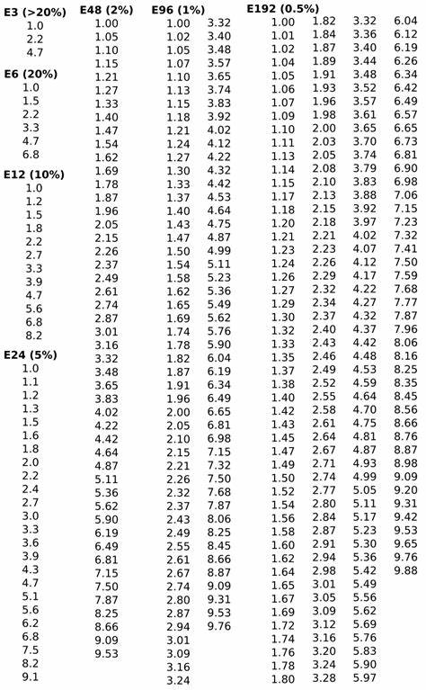

Slide 2
SMT resistor
Reed
Switch
Solder
Pad
PCB
Routed
slot

